Slide 1

Moonraker
Visualizing Cloud Native Application Bundles
Chance Murray, Dan Kindt, Gabe Coelho, Grant Purdue & Madison Robertson
Notes:
Speakers: Madison (10 seconds) 0:10
--------------------------------------------
I am Madison Robertson, this is…..
And we are Moonraker!
For our capstone project we are working with Microsoft to visualize cloud native application bundles.

Slide 2
Project Objective Statement
Create a tool to help users view the data associated with their cloud-native application bundles by
April 10, 2020.
Notes:
Speakers: Madison
--------------------------------------------
Our mission for these two semesters is to create a tool to help users view the data associated with their cloud-native application bundles by April 10, 2020.
In order to understand our project, it's necessary to understand what cloud-native application bundles are, who our stakeholders are and why we need a solution.

Slide 3

CNAB
Cloud Native Application Bundles
Notes:
Speakers: Chance
--------------------------------------------
To understand what we are trying to do, it is important to understand what Cloud Native Application Bundles are at a high level.
What is a CNAB?
According to Github, Cloud Native Application Bundles (CNAB) are a package format specification that describes a technology for bundling, installing, and managing distributed applications, that are by design, cloud agnostic.
More simple: A Cloud Native Application Bundle (CNAB) is a pairing of a bundle definition (bundle.json) to define the app, and a customized (Docker Container) that contains the steps for installing, upgrading and uninstalling the app.
Makes distributions across teams easy
Makes deployments of multi-part applications simple.
Example:
Multi-Cloud App
CloudFront in AWS
Kubernetes in Google Cloud
Database in Azure
We will not be discussing the process of creating bundles in this presentation. For more information, please refer to your handout or find us after the presentation.
----------
Grant’s Thoughts:
What is a CNAB?
A container image (e.g. docker) that includes configurations and scripts for installing/updating/etc an application and its associated services

Slide 4
Stakeholders
Our sponsor, Microsoft
DevOps and infrastructure teams
Site reliability engineers
System administrators
CNAB users
Notes:
Speakers: Madison
--------------------------------------------
CNAB is a great tool being developed by and for many people.
The intended use is for
For our project, we are trying to address the needs of:
Our sponsor, the Microsoft open source development team
DevOps and Infrastructure teams
Site reliability engineers
System administrators
Anyone using cloud native application bundles

Slide 5

Alice
Site Reliability Engineer
Uses Cloud Native Application Bundles
Needs to view info on installed bundles
Notes:
Speakers: Madison
--------------------------------------------
One of our main users could be Alice.
Alice is a site reliability engineer on a team using cloud-native application bundles.
Alice inherited a cluster of containers from a co-worker and needs to understand what has been installed on them.
She needs a quick way to see what’s been installed and how it will help her deploy her team’s code.

Slide 6
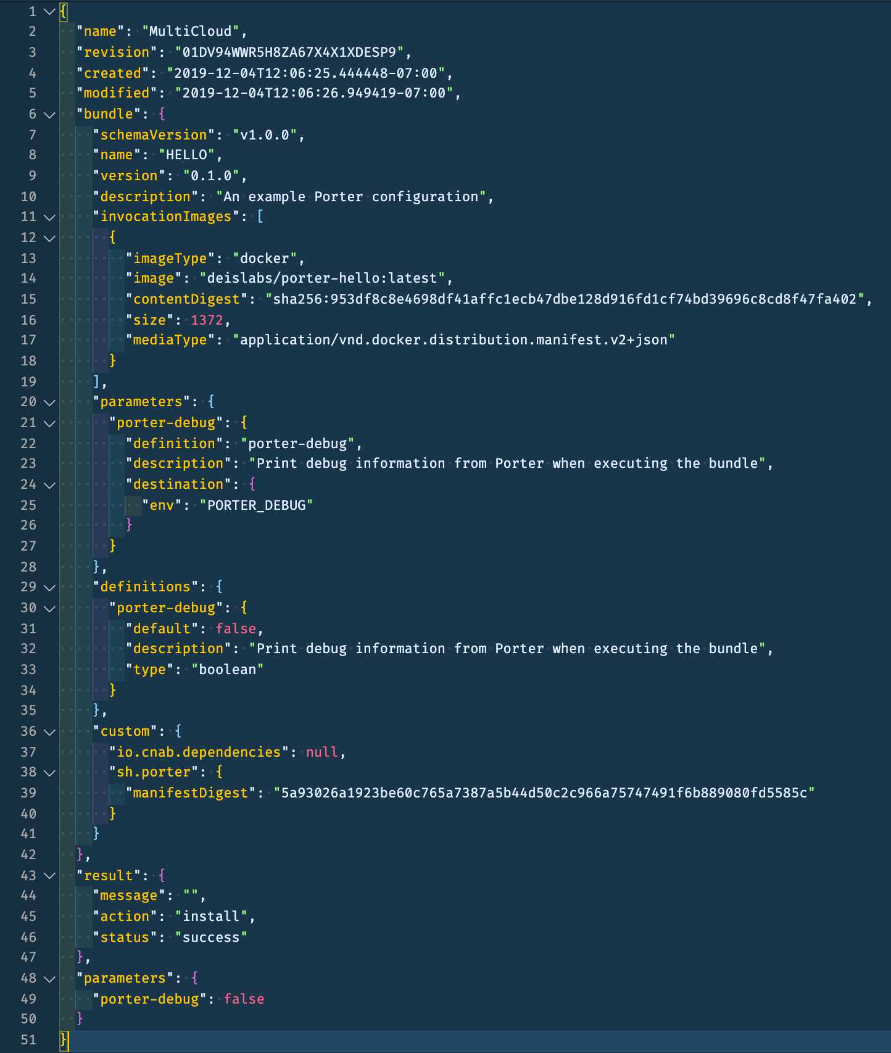
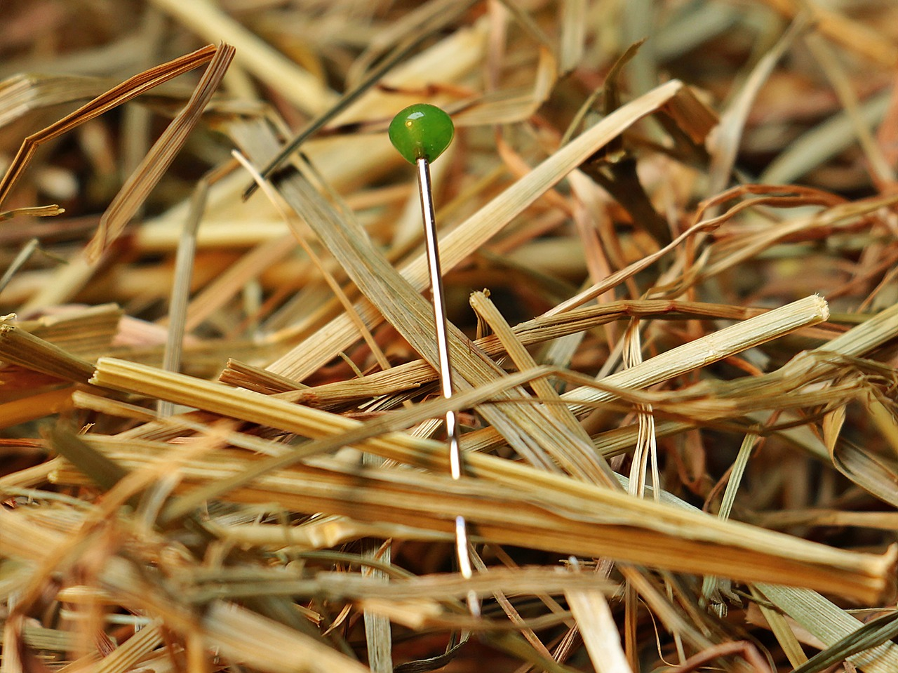
Current Solution
Notes:
Speakers: Chance () 0:00 actual
--------------------------------------------
Questions we would have installing CNAB:
Did CNAB install everything correctly?
What is the latest install version?
How do I keep track of my bundles?
Current Solution
Multiple CNAB CLI tools
Only shows bundles for that tool
How do the tools work?
Claims files are created and updated with every CNAB action
The file is a minimum of 50 lines long
The information that users like Alice need is like finding a needle in a haystack
These claims files have a lot of information, some of which isn’t needed for a Site Reliability Engineer like Alice, and can be difficult to read
It takes time, energy and deep understanding of CNAB documentation to find data on installed applications.

Slide 7
Project Objective Statement
Create a tool to help users view the data associated with their cloud-native application bundles by
April 10, 2020.
Notes:
Speakers: Chance () 4:40 actual 5:22
--------------------------------------------
Bullet Script:
Working with the CNAB open-source developers from Microsoft, we will create a visualization tool to help users view the status of the cloud-native application bundles by April 10, 2020.
This is so that our user, Alice, can view the information she needs at a glance, without having to go into her logs and find the information manually.

Slide 8
Deliverables
Fully documented API
Dashboard for viewing data
Notes:
Speakers: Dan (30 seconds) 5:10 actual 4:36
-----------------------------------------
To create our visualization, we must create an API and develop the dashboard. We will elaborate on these steps later.
Bullet Script:
Dan:
Deliverables:
Create a fully documented API
Develop a front-end dashboard for viewing data
We want our dashboard to show:
Bundles installed
Recent bundles
Installers
Bundle status
Mixins
...for our user

Slide 9
Milestones
Define project
Proof of Concept
April 10, 2019
Deliver final
API & Dashboard
October 6, 2019
December 6, 2019
November 1, 2019
February 15, 2019
Research
API & Dashboard (BETA)
Notes:
Speakers: Gabe (1 minute) 6:10 actual 3:23
-----------------------------------------
All Milestones:
Project definition (scope)
Research
Build prototype
Build API
Build dashboard
Completed
Define project
Research
Prototype
Future Goals
API
Dashboard
Deliver final product
Bullet Script:
Gabe:
Each box is a milestone, our goals are in gray and our completed milestones are in yellow
To handle any changes or unpredictable events, we are focusing our efforts on completing a BETA version by February 15th
That will leave us two months to work with any dependencies and code anything we don’t foresee now

Slide 10
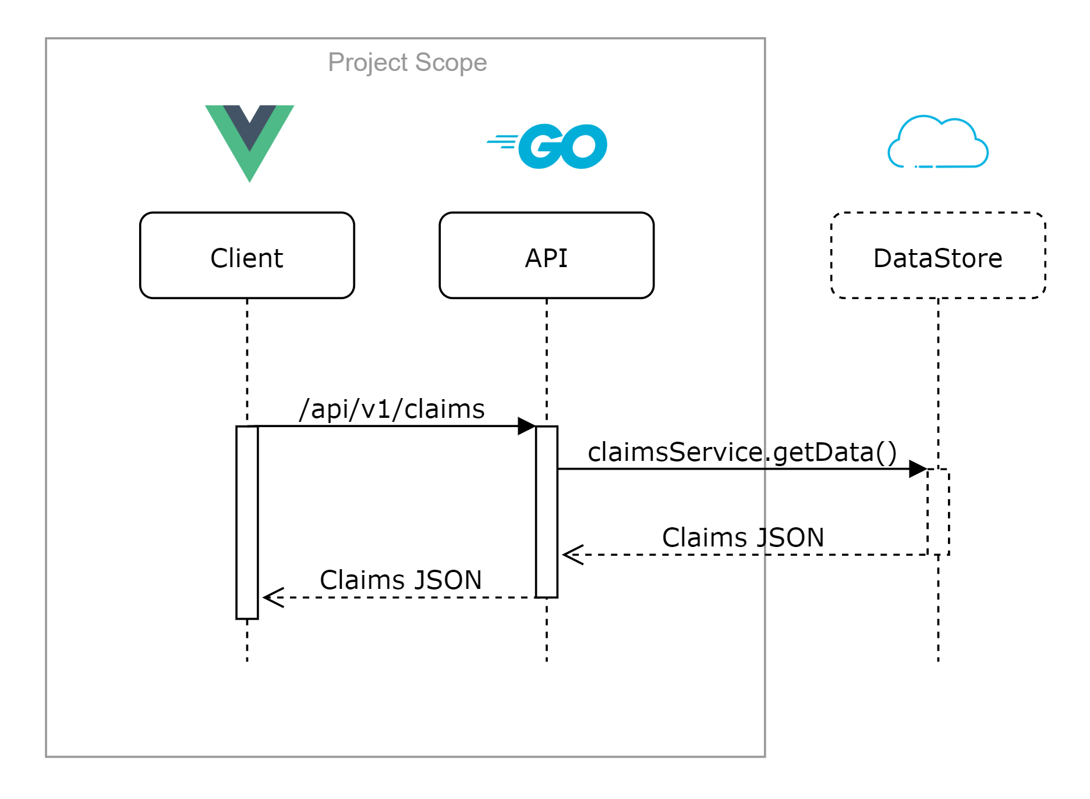
Technologies
Notes:
Speakers: Grant (80 seconds) 7:30 actual 1:33
-----------------------------------------
***Clarify what is in and out of scope
Bullet Script:
Grant
Different methodologies for different layers
Data Store: Any
Not our domain, but we need to be able to handle as many as possible from our API
Go Plugin is already being developed by our sponsors
Back-end (API): Go
Open-source CNAB community already uses it
Can exploit services that are already being developed in Go
Communications: JSON over HTTP
Tons of support
More human readable
Makes dashboard tech-agnostic
Front-end (Dashboard): Vue
Very shallow learning curve
Already has great open-source dashboard templates

Slide 11
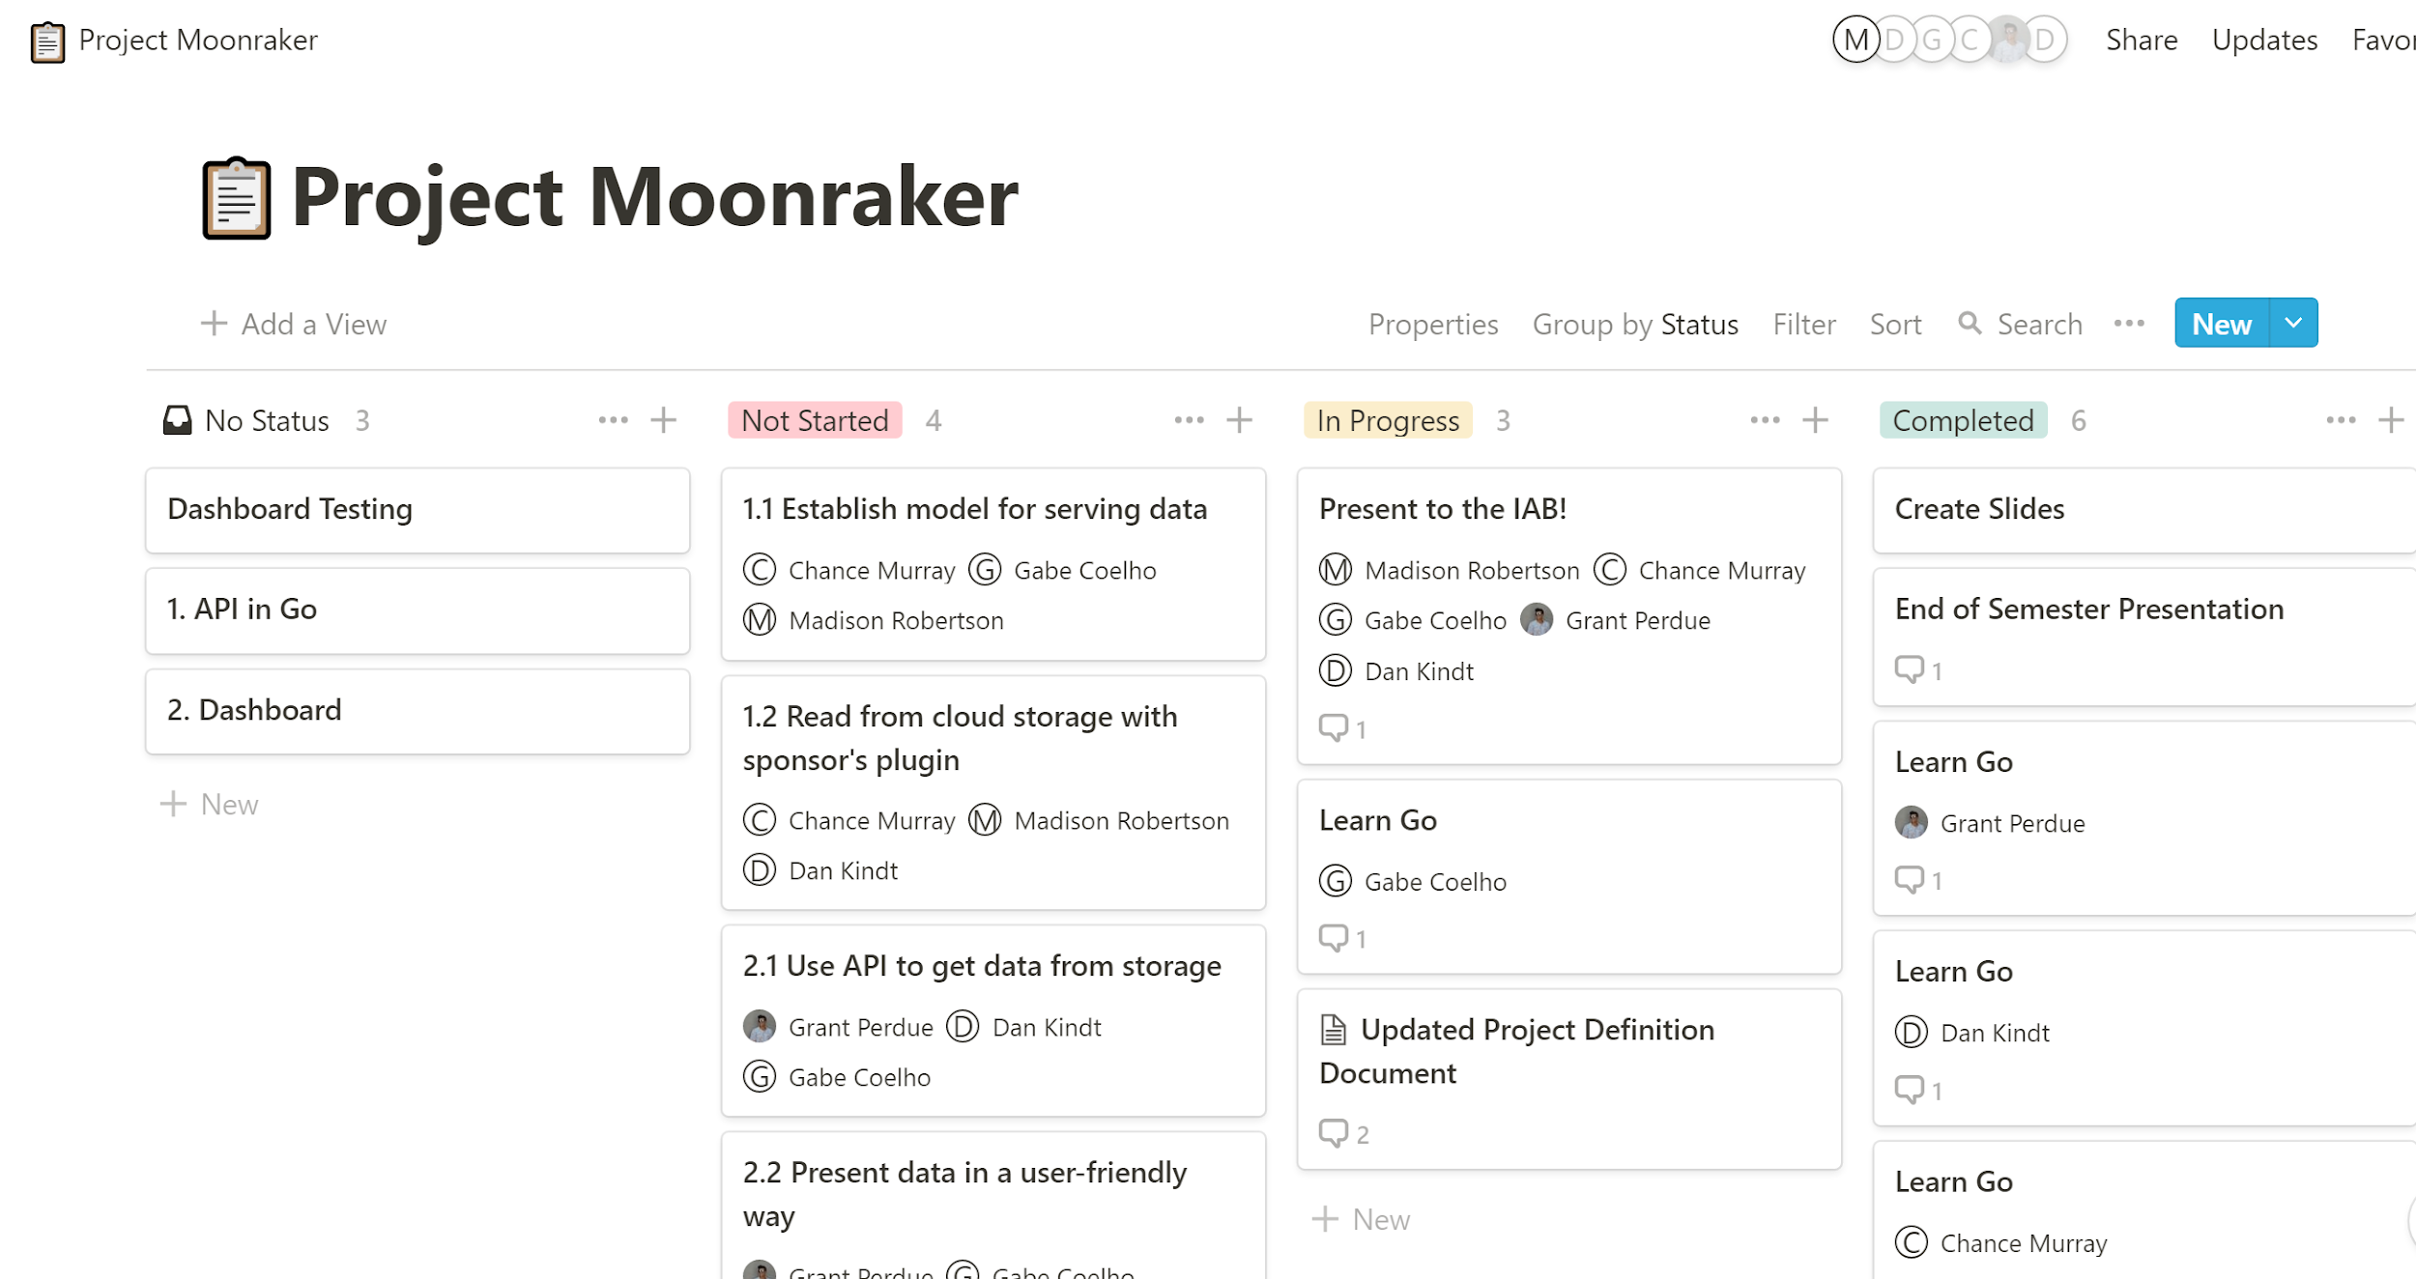




Project Management
Notes:
Speakers: Dan (20) 7:50 actual 0:55
--------------------------------------------
Bullet Script:
To get Alice her project by April 2020, we’ve broken down the project into these tasks
We will use Kanban-Style for Task Management
Notion.so and
Google drive folder for collaboration
Github to store our code
Task breakdown:
1.0 Create an API to collect data from cloud storage
Establish model for serving data
Read from cloud storage with sponsor’s plugin
2.0 Develop a front-end dashboard for viewing data
Use API to get data from storage
Present data in a user-friendly way

Slide 12
Demo
Notes:
Speakers: Chance (2:00 minutes) 9:50 actual 0:16
-----------------------------------------
No bundles: show empty api response
Install two - three bundles: show response
Mention pain points
Switch to the dashboard
Can easily view key data points
Update a bundle
Watch data update in real time.
Goal to include more key data points and obviously make it look better :)

Slide 13
Alice
Notes:
Speakers: Madison
--------------------------------------------
Madison
Our dashboard will enable Alice, our example user, and her team to have a shared view of their bundles- giving them all the information they need in the moment they need the information.
Upon completing our project, Alice will have a quick way to document and find out information about her cloud-native application bundles- helping her complete her job efficiently and get her company’s code deployed in the best cloud environments.

Slide 14
Notes:
Speakers: Madison
--------------------------------------------
We really apreciate you coming out and hearing about our project.
Are there any questions?

